Slide 1

How to choose your next wine

Slide 2
Wouldnt you like to be able to use coding to determine which red or white wine to choose?
Could it be that easy ? To not have to walk aisles aimlessly and blindly choosing wine to see if you will like it ?
Well that is what I set to find out .

Slide 3
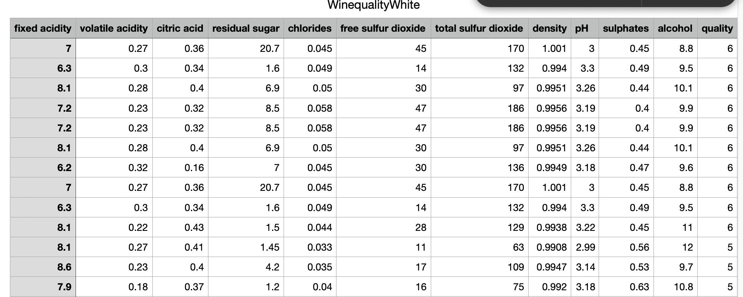
Here is a snapshot of the White Wine dataset I will be using .

Slide 4
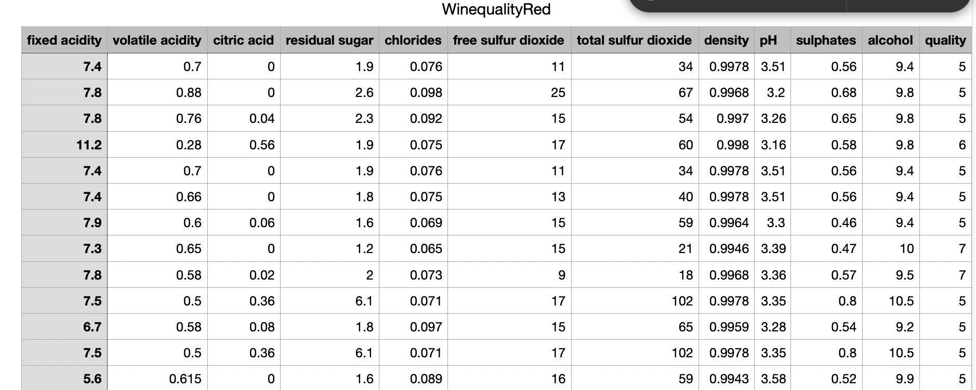
Here is a screenshot of the Red Wine dataset

Slide 5
As You can see the dataset has 12 columns

Slide 6
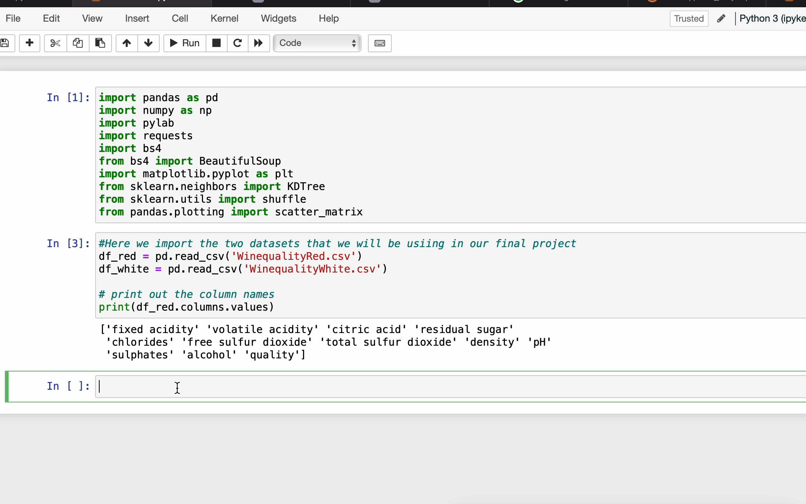
As you see here the data sets are not equal in size , so we need to lower the white wine data to match the red

Slide 7
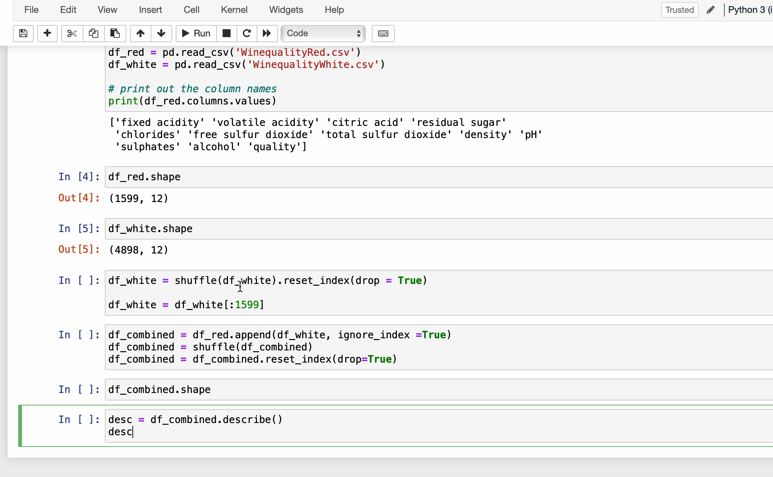
Because we do not want to be biased we need to shuffle the data and make it equal to the red white data amount and then make sure that the dataset was actually combined.

Slide 8
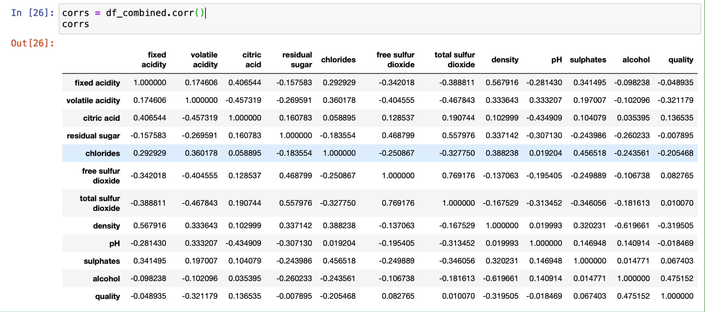

Slide 9
Since there was no direct correlation between an ingredient or ingredients to quality using the combined dataset it was time to see if one specific ingredient had a correlation to quality. So I decided to plot each one against quality to visually see.

Slide 10
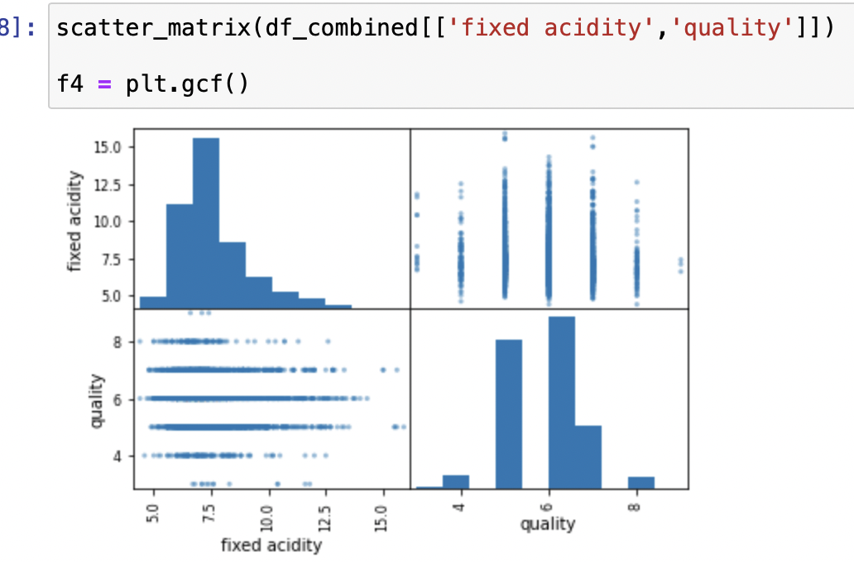
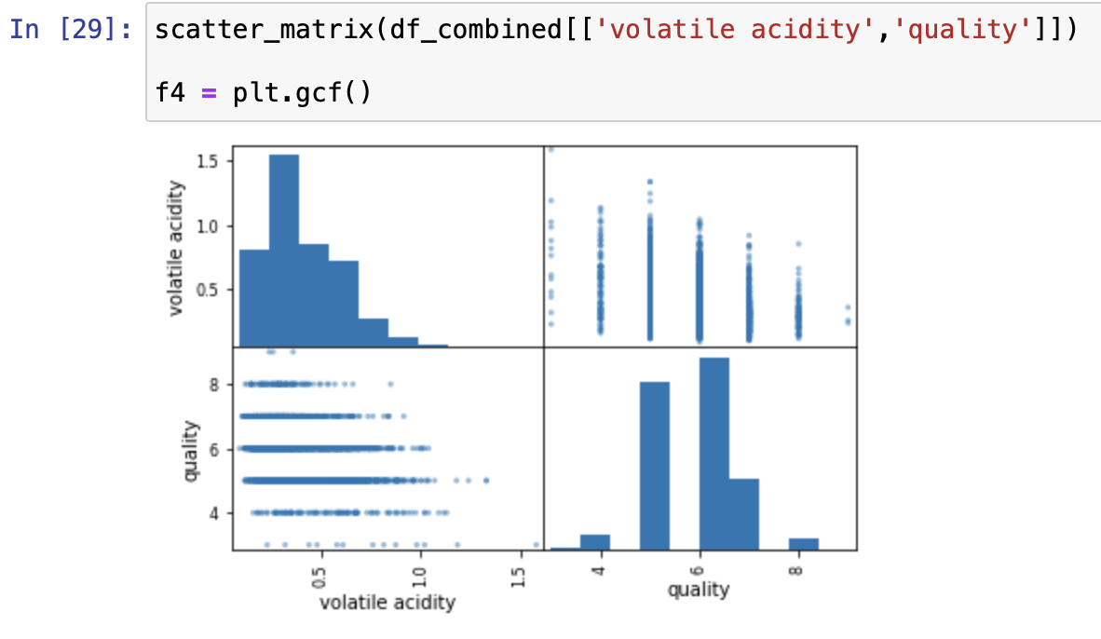
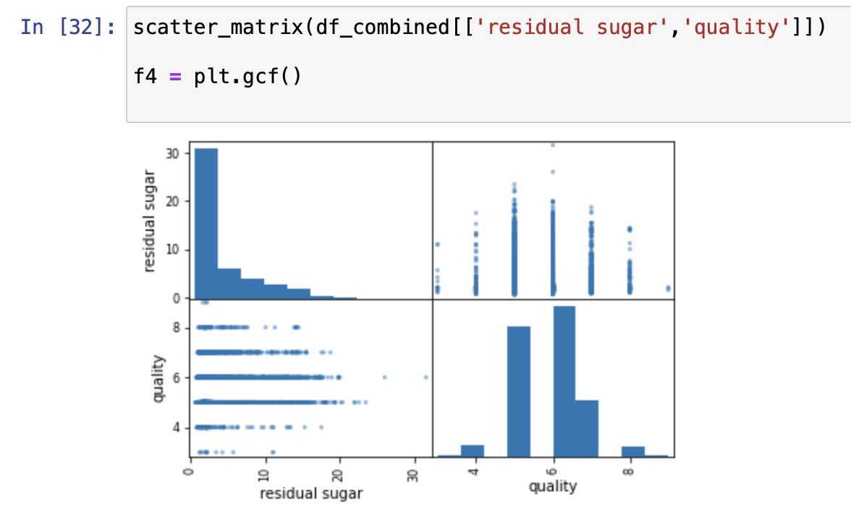
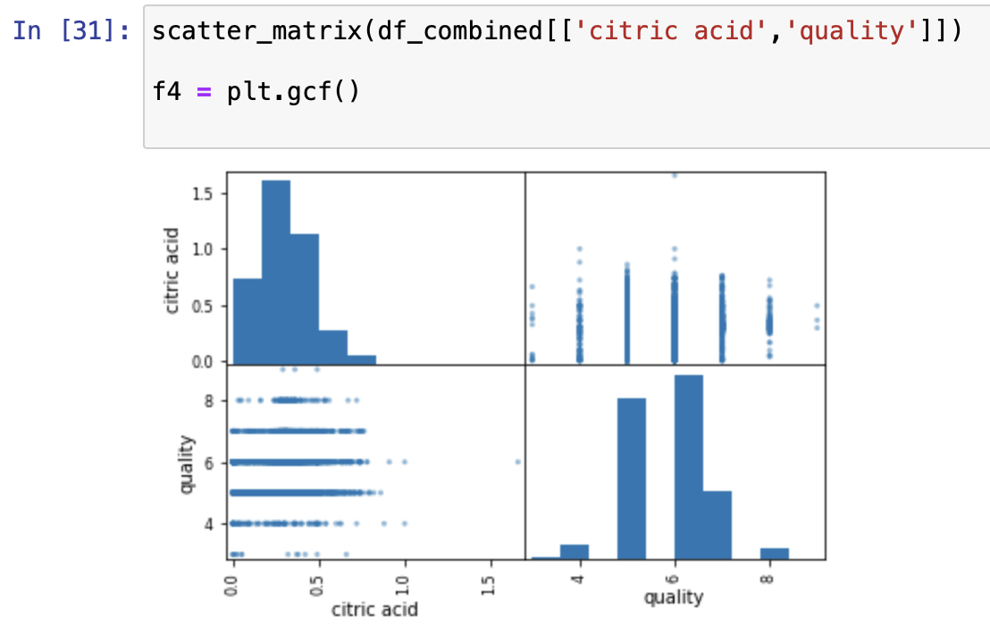

Slide 11
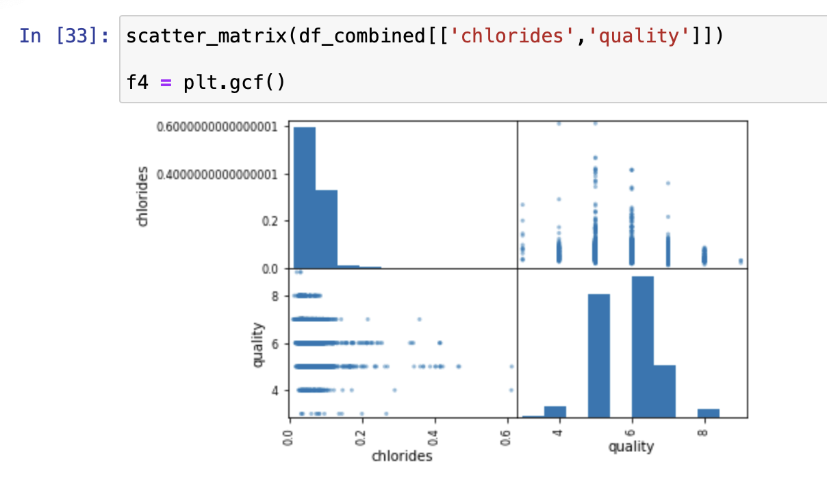
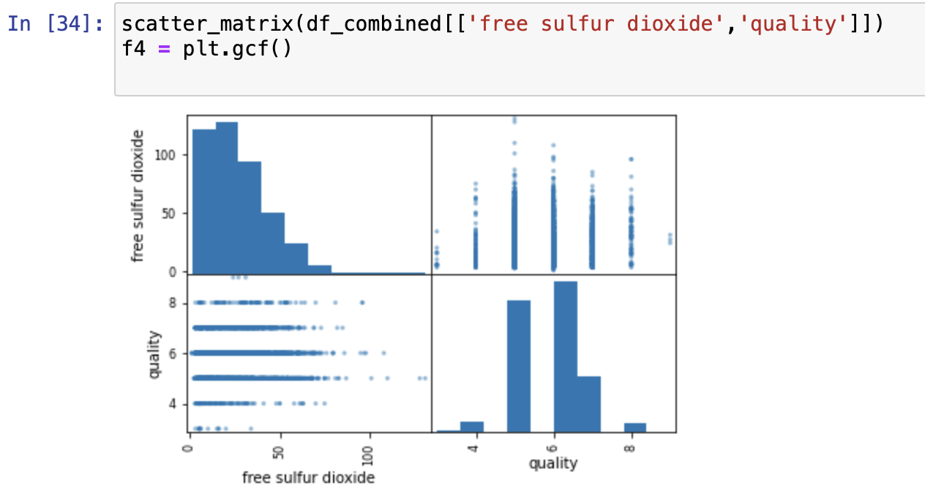
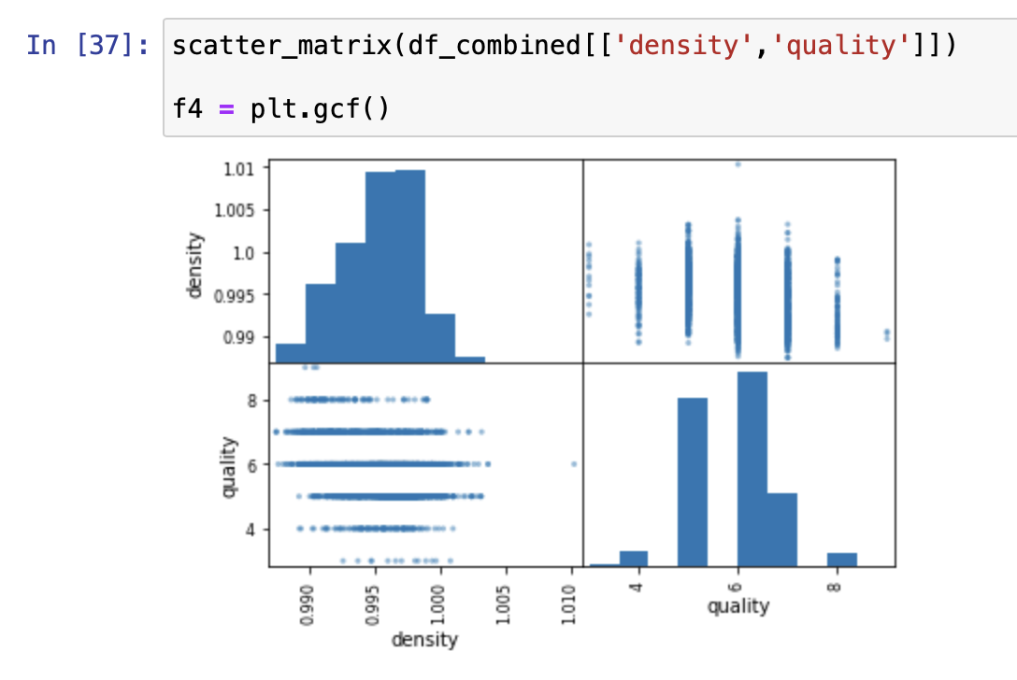
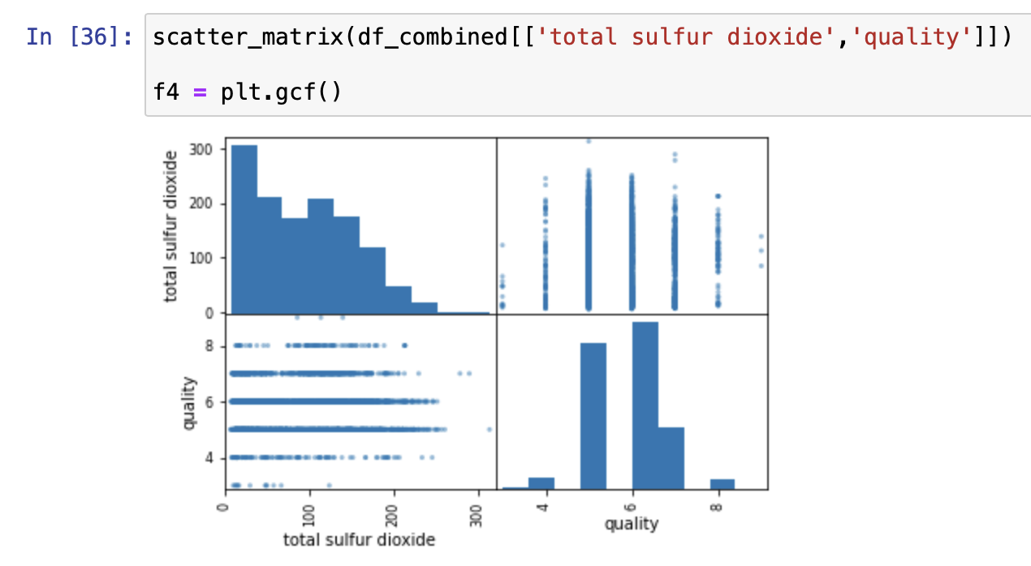

Slide 12
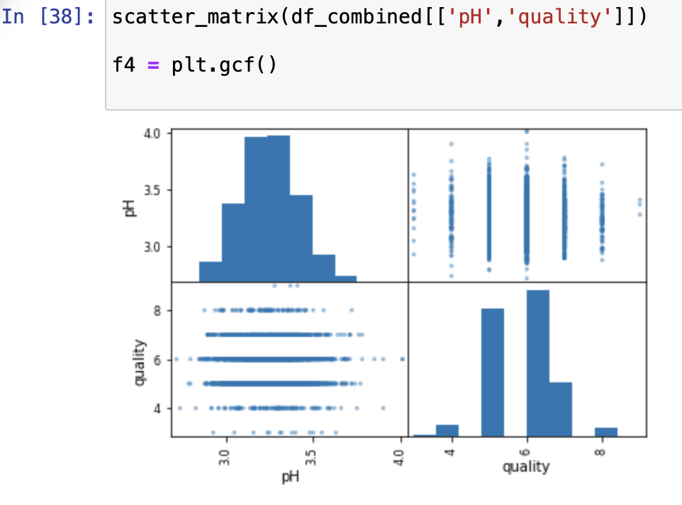
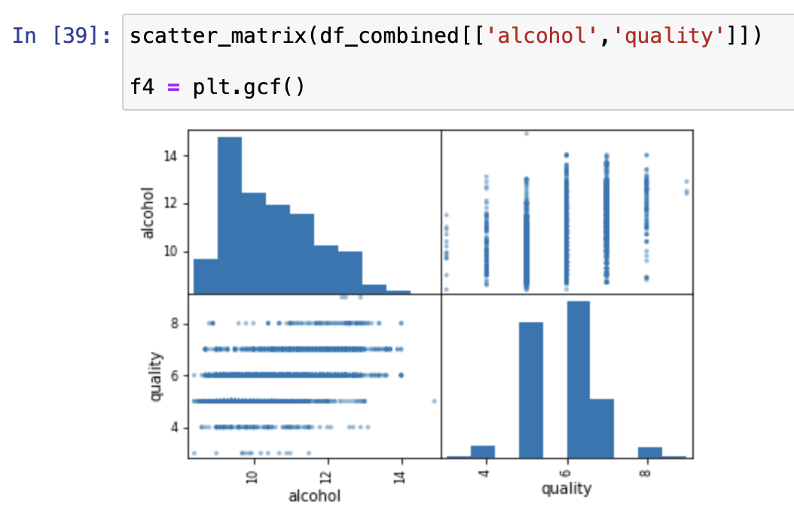

Slide 13
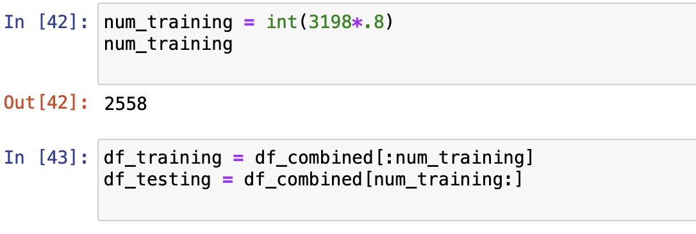
To dive further into the data I created a training and testing dataset.
The training set will be 80 percent of the data and the testing 20 percent

Slide 14
Now that I combined the data and looked at the plot maps and correlation it's time to dive deeper and see if we can predict wine quality. So I decided to use a KD tree to store the wine data but I need to determine what k value is best to use.

Slide 15
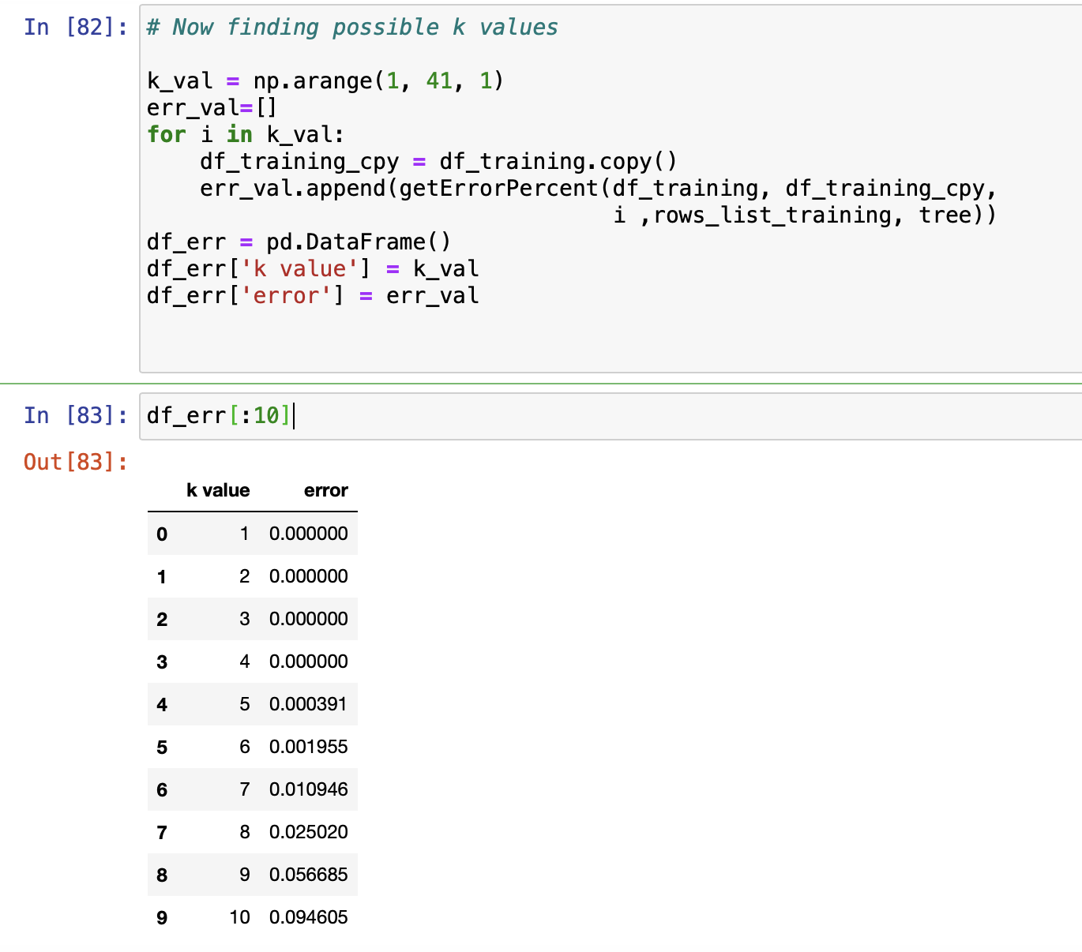

Slide 16
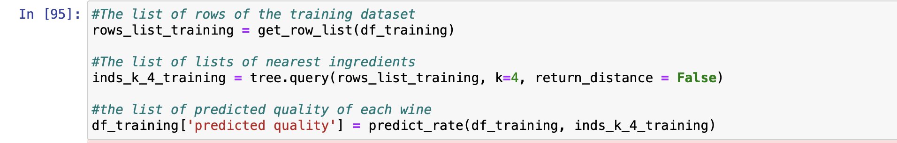
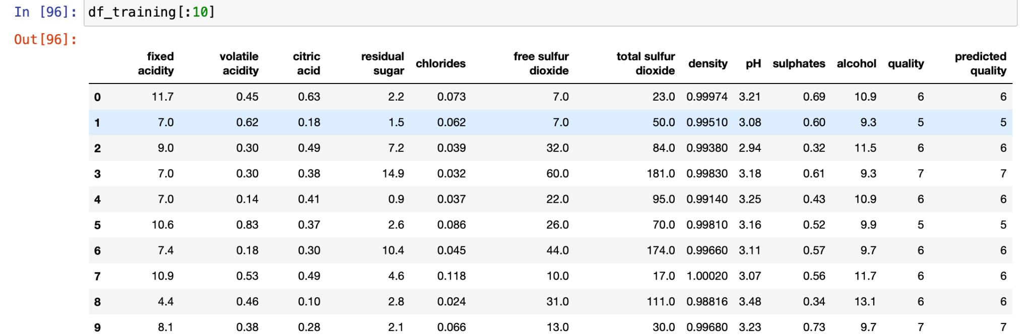
This will take the training data with the k value I choose and predict the wine quality

Slide 17
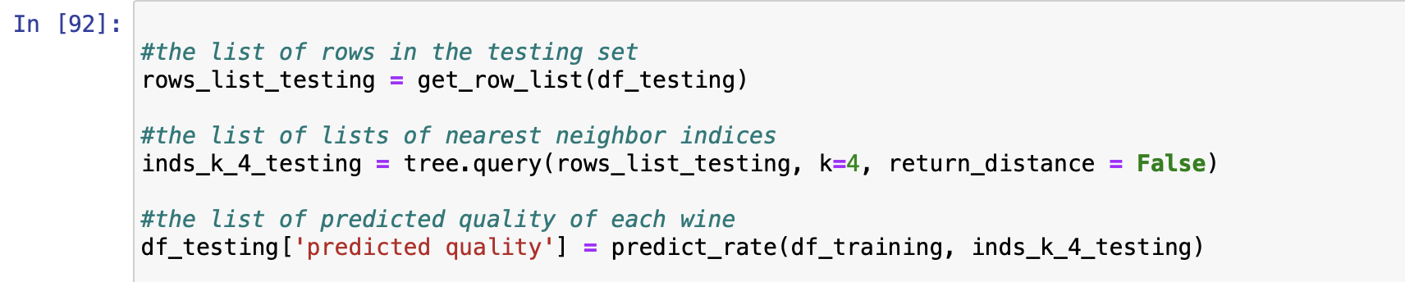
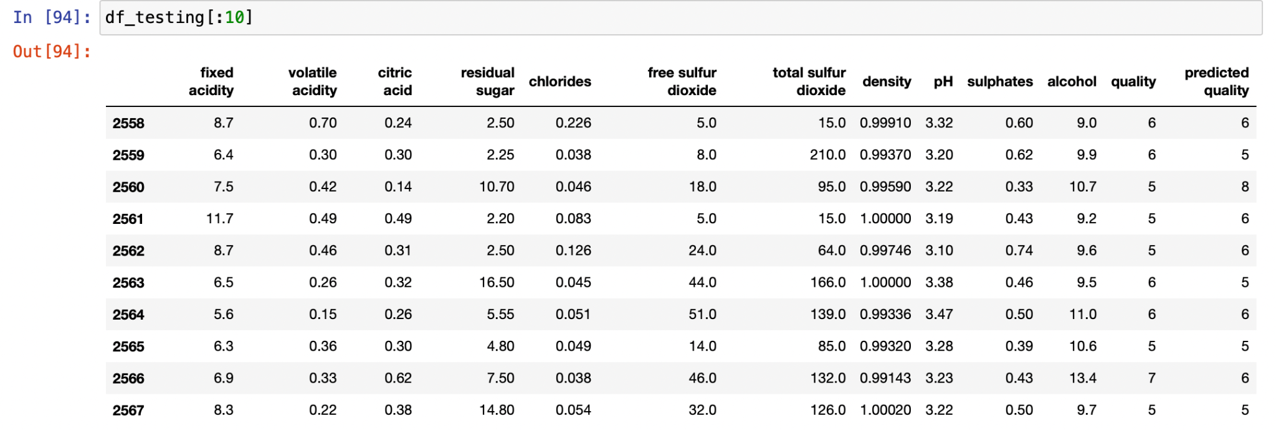
Now the same for the testing dataset

